Slide 1
“Thinking about causes” session
Ben Whalley

Slide 2
What are we trying to achieve?
Generate a causal model: say how the world works; entail predictions.
Make measurements
Does our data fit our predictions?

Slide 3
Task 1
Choose an outcome
Effectiveness of psychotherapy
Coping with chronic ill health
Student satisfaction
Identify 5 - 6 constructs or variables related to that outcome.

Slide 4
Variables In a nutshell
Things we can measure (observations)
Things that cause other things, even if we can’t measure them (constructs)

Slide 5
Task 1
Identify 5 - 6 constructs or variables related to that outcome.
Draw lines to link them together
How strong is the evidence for each link?
Discuss “missing links” and mediation

Slide 6
Task 1
Identify 5 - 6 constructs or variables related to that outcome.
Draw lines to link them together
How strong is the evidence for each link?
Discuss “missing links” and mediation

Slide 7
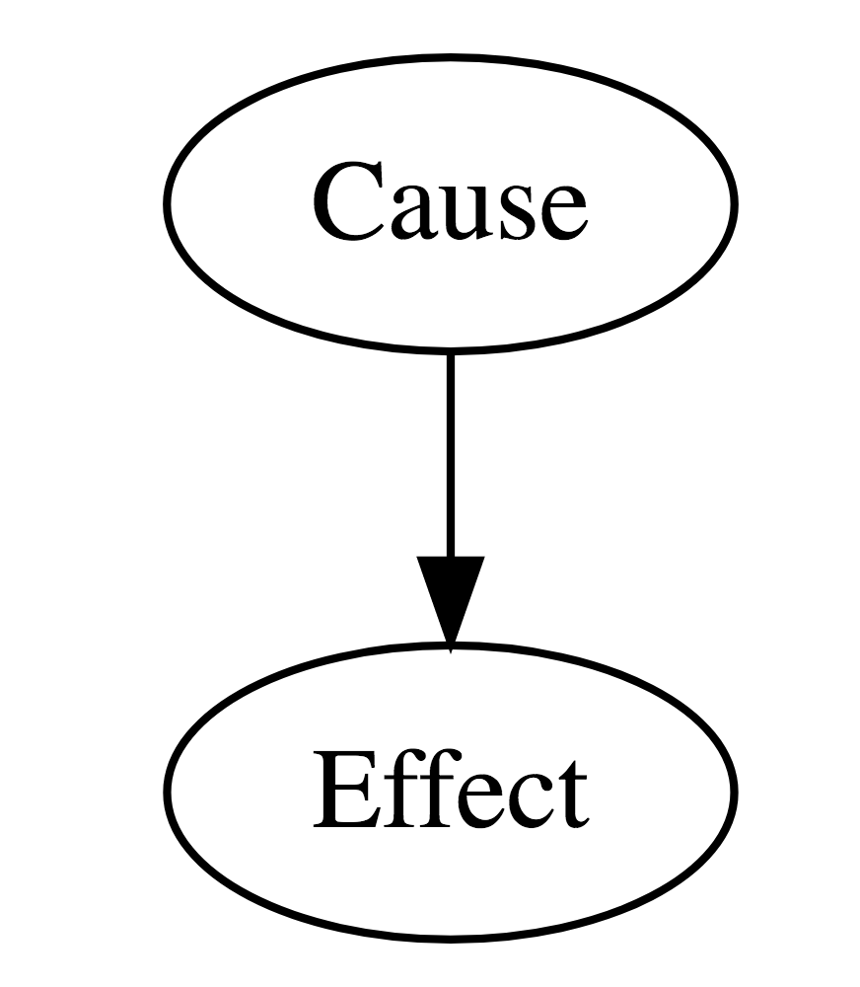

Slide 8
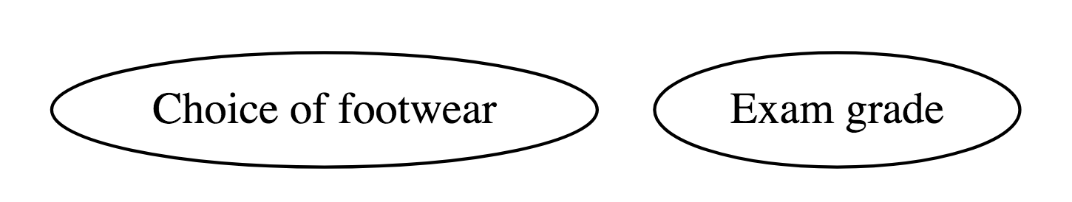

Slide 9
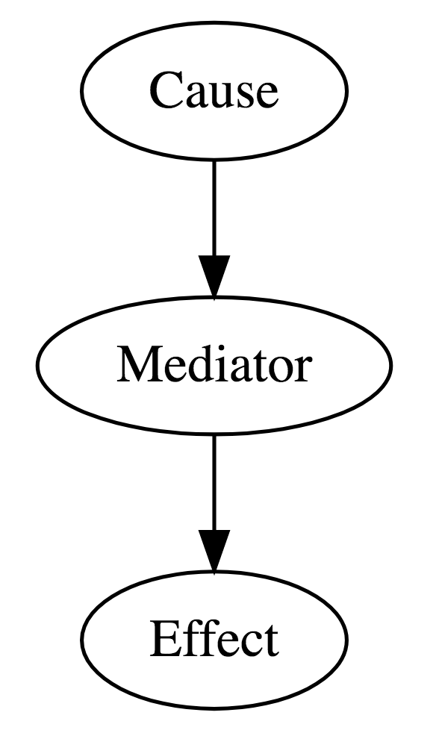

Slide 10
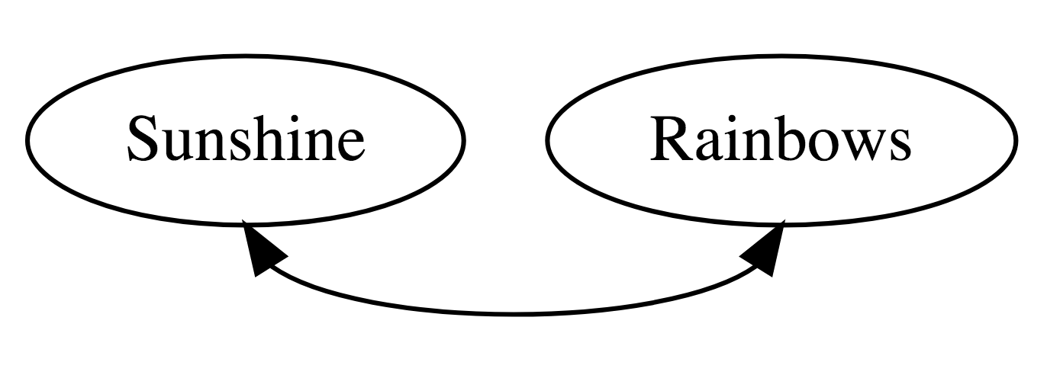

Slide 11
Task 1
Identify 5 - 6 constructs or variables related to that outcome.
Draw lines to link them together
How strong is the evidence for each link?
Discuss “missing links” and mediation

Slide 12
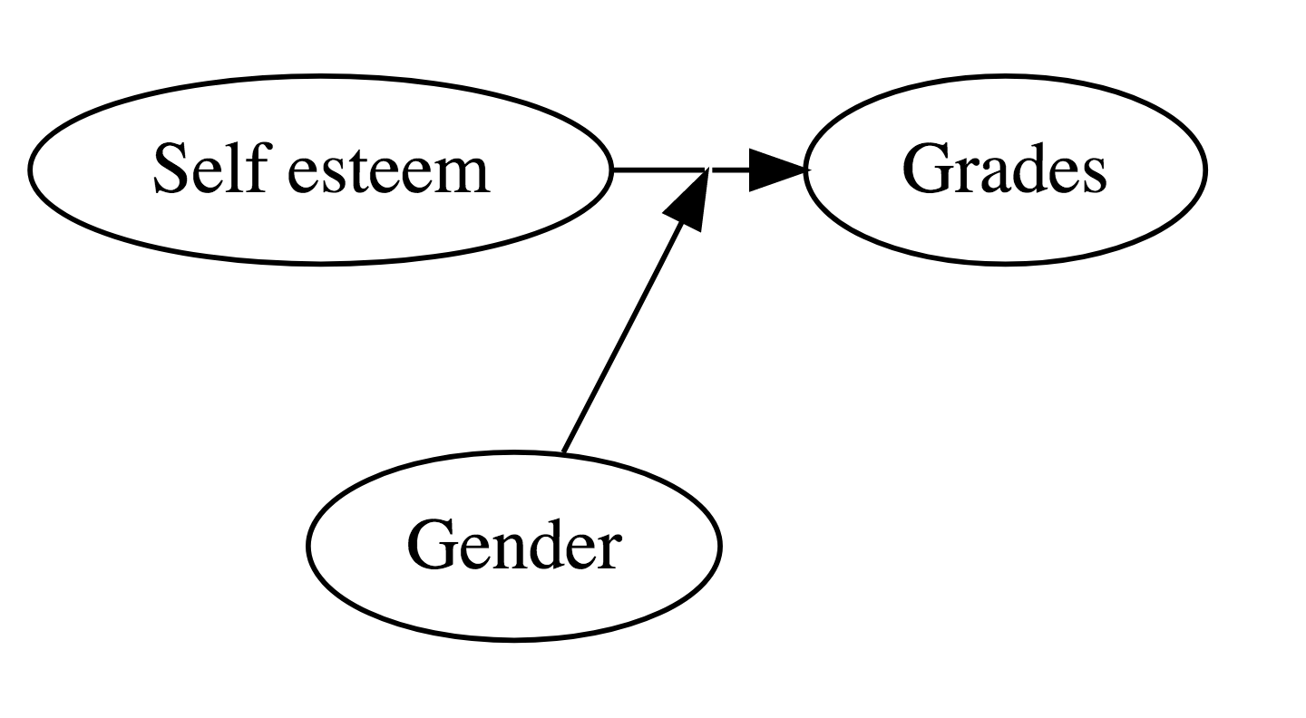

Slide 13
Task 2
Add examples of possible effect-modification/moderation to your diagrams
Discuss how likely you think they are
How could you collect evidence for this?

Slide 14
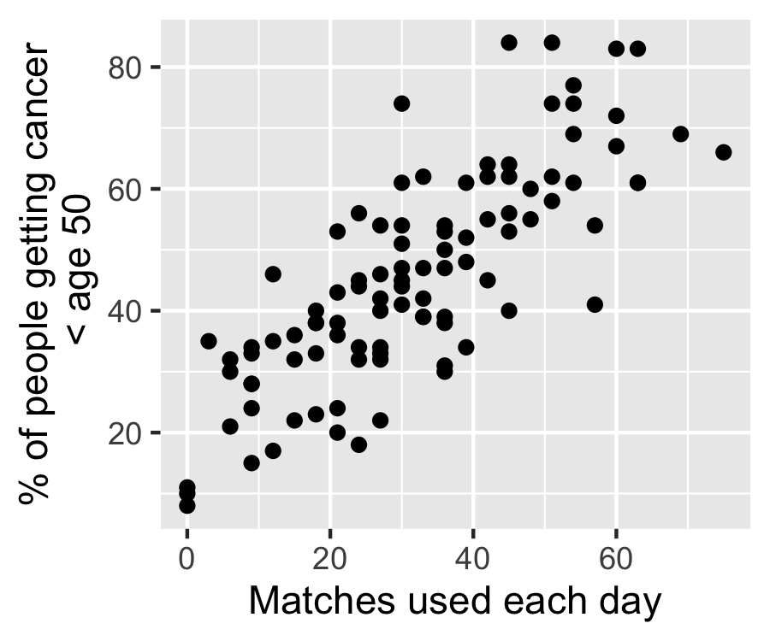
Task 3
Draw out the causal diagram for this plot
There are two variables shown in the plot, so include two boxes in your diagram.
Use arrows (or not) to explain what you see in the data

Slide 15
Task 3
Draw out the causal diagram for this plot
Add at least 1 variable (box)
Convert any correlations to directed arrows
Make your diagram match what you think the ‘true’ state of the world is.
What’s happening here? Have you come across other examples?

Slide 16
What to do?
Experiments make confounding impossible
Design studies to make it less plausible
Control for “all” the confounders (and be cautious)

Slide 17
Why are graphical models important?
Causal models are mapped to statistical models
But! There’s no guarantee our stats test the model of interest (we need to be careful)
The inferences we draw are dependent on:
Whether the assumed causal model is correct
That our statistical model match the causal model
Excellent communication tool for researchers
See Pearl and Mackenzie, 2018 (ref on website)

Slide 18
Experiments simplify
Experiments simplify a complex model by helping answer a counter-factual question
“What would happen if a kept all the variables the same, except for one which I change?
In this way, we can test each link in the chain in turn
Science is an iterative activity!

Slide 19
Regression does the best it can!

Slide 20
Difficult cases
* You can do this, but it’s tricky

Slide 21
Details
+ positive linear relationship
– negative linear relationship
∩ starts positive but reverses
∪ starts negative but reverses

Slide 22
Real examples
Doll et al. (1994)
Seidelmann et al. (2018)
Draw out a causal diagram of all the variables mentioned in the paper
Be sure to add possible confounders or unobserved variables — even if they are not measured or considered by the authors.
How does drawing out the diagram affected your understanding of the results?

